Slide 1
Welcome
Paula Hunter, Executive Director, Mojaloop Foundation
Rwanda, March 7, 2023

Slide 2
Meet our Team
Simeon Oriko, Director of Community
Steve Haley, Market Development and Partnerships
Desire Kachenji, Manager of Grants and Partnerships
Paul Makin, Product Management
Megan Cannon, Community Operations

Slide 3
Our Top Priorities
Deployment Successes
Product Alignment to Market Requirements
Continued Growth in our Community

Slide 4
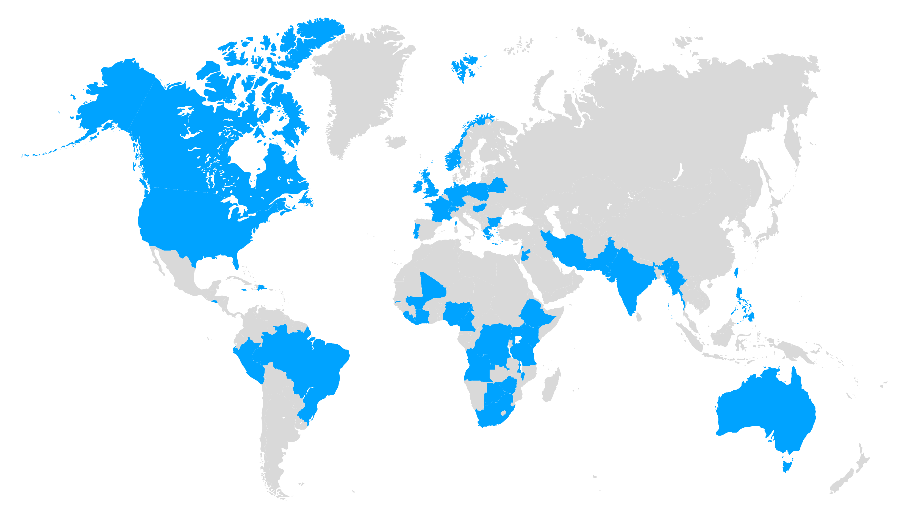
Many Thanks to Mojaloop Community – Thank You!
600+
6
47
Active participants and growing!
Continents
Countries
Notes:
The Mojaloop Foundation, with the funding and support of our sponsors will continue to advance the features and capabilities of the platform and support the community committed to our mission.

Slide 5
Have a great week!
phunter@mojaloop.io

